Slide 1
Strategies and Actors in Financial Markets Financial System as a Network of Intermediaries
Amine Raboun, Ph.D
Quantitative Researcher & Developer - Abu Dhabi Investment Authority
Lecturer, Paris Dauphine – PSL University

Slide 2
Course Description
What will we talk about ?
Financial markets are an ecosystem with inputs and outputs, since you will have a role in this ecosystem, you need to understand it.
We will speak about all aspects that are not covered with classical courses.
Our goal will be to give you key information about your future environment.
Hence, you will be able to evolve and take decisions while being aware of your immediate neighborhood

Slide 3
Course description
Sessions (12:00 – 13:30)
8 sessions of 1h30
With key people from the industry
Date | Title | Speaker
13 Jan | Organization of the Financial System | Amine Raboun
20 Jan | Market Microstructure and flow trading for intermediaries | Amine Raboun
31 Jan | Structured Products: Investment Banks offers & Investors needs | Christophe Lesieur
9 Feb | Risk management at the scale of an Investment bank | Pascal Gibart
16 Feb | Post 2008 Crisis regulation | Julien Leprun
17 Mar | The Investment Process in a changing world | Amine Raboun
21 Mar | IA and the Financial System: Will intermediaries be disintermediated | Charles-Albert Lehalle
28 Mar | Alternative data changing the investment process | Charles-Albert Lehalle

Slide 4
Session 1: Organization of the Financial System
Amine Raboun, Ph.D
Quantitative Researcher & Developer - Abu Dhabi Investment Authority
Lecturer, Paris Dauphine – PSL University

Slide 5
Outline: Organizatin of the financial system
Risk Transformation
A Macroscopic View of the financial system
Focus on Intermediation
Between different investors
In between investors, issuers and infrastructure
Who pays whom ?
Organization inside a brokerage firm

Slide 6
Risk Transformation
Let’s start with a story of micro-credit
Say you see a shoes shiner at New Deli, India
You pay $1 to have your shoes shiner, and you ask the guy
“It seems you have around 30 customers each day, it let you with $30 every day, it is a good job.’”
He answers: “not at all, I earn $1 a day... I do not own the brush. I borrow it everyday for the owner with a total cost of $29 a day.
Since a brush costs $40, you propose to lend the shoe shiner $ 40 for 2 days, in exchange for a $10 yield
The shoe shiner makes a profit of $10 (=30x2 – 40 – 10) on 2days and keeps the brush for ever, and you make a 25% return on 2 days loan
This is an example of basic risk transformation.
A liquidity risk transformation through time
Counterparty-risk: credit default either because of a lack of skill or bad luck.

Slide 7
Pure Agency Brokerage
By word of month, the investment opportunity spread out in the city, each time a traveler goes to New Deli, she looks for a shoe shiner to offer him a deal
An entrepreneur identified the need for an agency with two susidiaries
A French subsidiary where French investors ready to take the liquidity and counterparty risks make deposits in exchange of return
An Indian subsidiary where shoe shiner come to borrow the money
The agency gather the deposits in France, transfer it to India and keeps 5% of the return. The final investor is left with 20% yield instead of 25%
Creation of pure agency service to acheive the same result while reducing the cost
It replaces the high fixed costs of plane tickets + the effort to find a shoe-shiners looking to borrow money with the operating cost of maintaining a balance sheet in France and India
It splits the fixed costs on all participants
It creates a marketplace for liquidity to form and concentrate

Slide 8
Making the market, Inventory risk, One sided risk
and systemic crisis
After some months in a pure agency business:
On average 5 investors make a deposit and 5 shoe-shiners come to borrow it.
With 2 hours average waiting time between two arrivals, some investors lose patience and leave before the agency could provide them with a contract
A bank propose to play the rôle of the couterparty of buyers and sellers in both agencies
The broker introduced Market-Making. Its role is to buy from sellers and sell to buyers as they manifest in exchange of a markup. A bid-ask spread is born. The market is far more liquid (10 contracts on average)
Compared to the pure agency business, the agency have now some skin in the game. It bears the inventory risk.
After a couple of years, almost all shoes-shiners in New Delhi bought their brush
The agency continued to guarantee returns to depositors, however the number of shoe-shiners declined sharply
Bad inventory management creates One sided risk. Should the agency go bankrupt, all running contracts are null even if the shoe-shiner are willing to pay back the money -> Systemic crisis Regulator introduce Clearing

Slide 9
Risk structuring, Unconflicted advises and
stabilization of the system
After some credit default events, the agency introduced some clauses to the contract:
The shoe shiner must buy a brush with the borrowed money
In case of default, the agency gets the brush back. By reselling it, it recovers part of the investment (Recovery Rate)
The broker introduced collateralization. It stabilizes the system by limiting the risk born by investors
After an in-depth study of the shoe-shining business, the agency understands better the risks
Depending on the shoe-shiner location (street, shopping center..), skill, and statistical revenues, the agency attribute
a note to each contract
The broker puts in place a variety of contracts with a large range of yields corresponding to different levels of risk
under the moto “Higher Risk Higher Return”
The agency publishes a weekly newsletter, with pending offers and transparent rankings of contracts
The broker introduced Risk Structuring. By repackaging high and low risk together. It achieves a better capital allocation. With complex risk packaging, the final investor need Unconflicted Advice

Slide 10
Lessons learned from this tale
Why do we need the financial system?
First, we need to have natural buyers and sellers of the same risk outside the financial system.
A pure agency business can be introduced between buyers and sellers. It concentrates the liquidity, provides unconflicted expertise and pays fixed costs that are now split between all participants.
Market makers can improve the liquidity of the market by putting themselves between buyers and sellers who would not be synchronized enough otherwise. They are rewarded by a markup, or by the bid-ask spread. As far as the market is not one sided, the balance between buyers and sellers is enough to maintain a smooth and orderly functioning market.
Collateralization is a good way to guarantee, at least partly, promised future returns.
If intermediaries' inventories grow too much in one direction, the risk of bankruptcy increases and when it happens the whole system freezes.
Clearing and careful monitoring of intermediaries’ inventory are key measures allowing to anticipate these issues.

Slide 11
Economics of financial markets
Ex post rationalization of intermediaries
Goal:
Optimize allocation of capital / resources
Thanks to the welfare theorem, provided
Means:
A fair access to unbiased (fundamental and technical) information
That prices are endogenously set by offer and demand equilibrium
Plus, rational choices of agents.
We should obtain the most rational allocation, corrected on the fly by market participants (provided that they are diverse enough).
Thus:
you need few points of access to information (to ensure its fair dissemination)
you need market liquidity so that the offer and demand balance is not disturbed.
Plus:
(more recently) you need to net and secure positions
As a regulator or a policy-maker, you count on intermediaries to ensure these three last points.

Slide 12
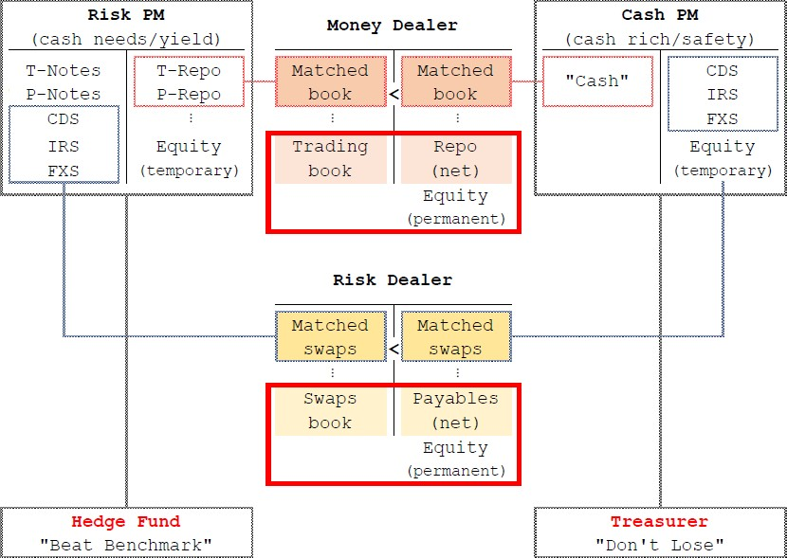
Economics of financial markets
On the one side (right) you have Cash PMs they are
cash rich but safety poor (fear to lose their money).
-> Amine Raboun
On the other side (left) you have Risk PMs, they have to beat a benchmark, thus are securities rich but return poor (need leverage and non linearities).
-> Amine Raboun
In between (middle) you have Intermediaries, they match Risk PMs on the asset side of their balance sheet and Cash PMs on the liability side.
-> Christophe Lesieur
They have to do this while controlling their risks
-> Pascal Gibart
This is accountancy, each time a transaction of this kind is made, it has to be marked-to-market, thus all this is pegged to traded prices.
Regulators are monitoring all this to be sure it happens a smooth and ordered way
->Julien Leprun.

Slide 13
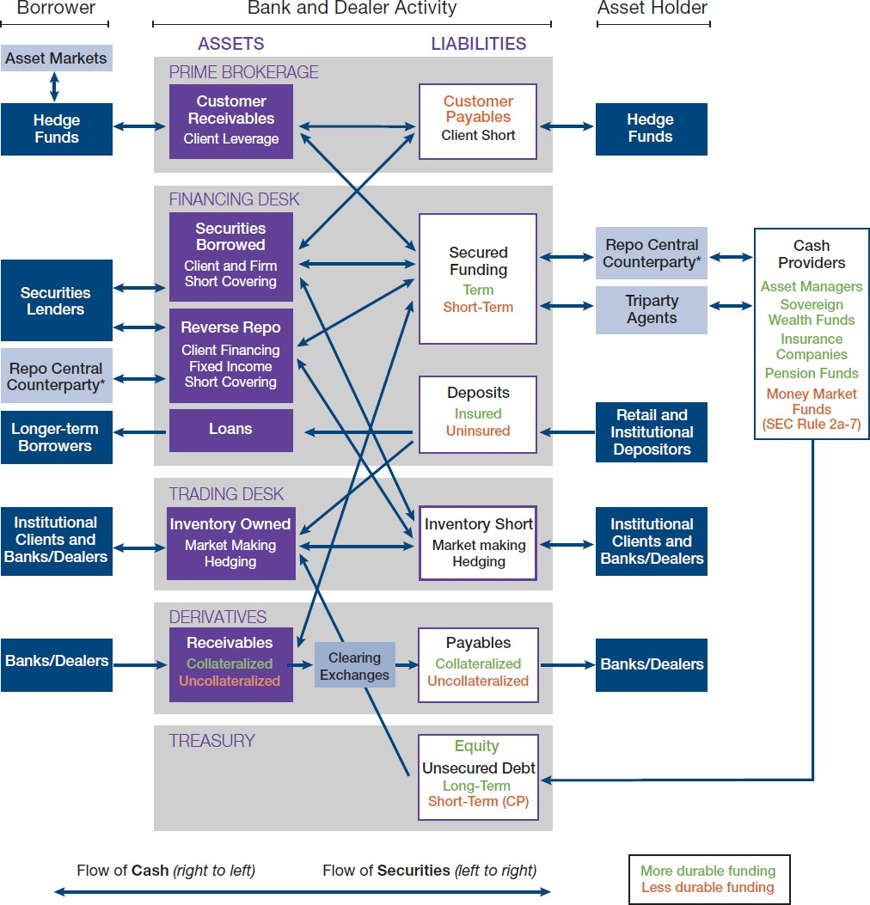
Economics of financial markets
Another (US) view of the same ecosystem.
In this diagram we have CCPs (Central Counterparty), Clearing Exchanges, and Triparty Agents (repo third-parties).
Having flow identified, regulated for unconflicted intermediaries makes regulators and policy makers comfortable .
Since the G20 Pittsburgh Summit (2009), the goal is to secure most of these transactions by cash or collateral deposit and netting (positions and contracts).

Slide 14
Rôle of intermediaries
As a regulator, you need intermediaries to:
net and secure the positions,
ensure a fair access to (fundamental) information,
facilitate liquidity and make the markets.
Remind that only 20 years ago:
you needed to be physically present during CEO/CFO speeches to have accurate information about firms, (40 years ago, it was the same for central banks);
you needed to seek liquidity each time you had in mind a large deal.
Technology (the Internet and electronic markets) changed a lot these two points for some asset classes (corporate bonds are not that liquid and ready-to-process information about debt structures of corporates are not that easy to obtain).
Disintermediation is going forward among financial markets. Like in other markets (press, media or goods sellers) big technological actors are emerging. They can lower the fixed costs (and achieve more netting) and have access to large B2B infrastructures. (see The Theory of Financial Intermediation: An Essay on What it Does (not) Explain, B. Scholtens, D. van Wensveen, 2003)

Slide 15
Intermediation of Risks
Going back to concepts mathematical finance is more familiar with
you are an investment bank. You sell a structured product or a derivative to clients;
you do not hedge each book separately (or at least you shouldn't): you hope to have other clients consuming other products flattening your risk inventory.
Of course, you will not succeed in netting 100% of the risk, hence you have to hedge the remaining book, in the markets
if you succeed into hedging continuously on markets (without liquidity, i.e. market impact issues), it just mean someone has the opposite risk in the market and hedges it on its side: you should could find it and net both positions
In this sense wrong way risk is not good for the liquidity on markets at all, you cannot believe you really hedge if you impact the price.
Two good but stylized examples in the literature are
(Option market making under inventory risk, S. Stoikov and M. Saglam, 2009) (High Frequency Market Making, R. Carmona and K. Webster,2012)

Slide 16
Intermediation of Risks
Function of the Financial System:
The Financial System transforms risks.
If a participant buys risk, without another participant sells it back, then the system accumulates risk
The only way the financial system does not accumulate risk is when it buys and sells risk outside of the system. It nets out risk from real economy.
Intermediation:
The financial system can be seen as a connected network of intermediaries.
Synchronization of buyers and sellers is crucial for intermediaries.
The more an intermediary has to wait a seller once he has sold, the more risk it will have to take.
Regulation is a calibrating this maximum amount of risk it is allowed to take.

Slide 17
Creation of Exchanges
Historically brokers were the founders (and only members) of exchanges
France: Bourse de Paris created September, 24,1724
Thanks to an “Arrêté du Roi'' Louis the XVth. In 1774: obligation to trade on the pit. 1801: monopoly of trading stocks for the existing 71 brokers.
Nyse creation: under a buttonwood tree on Wall Street
“We the Subscribers, [24] Brokers for the Purchase and Sale of the Public Stock, do hereby solemnly promise and pledge ourselves to each other, that we will not buy or sell from this day for any person whatsoever, any kind of Public Stock, at a less rate than one quarter percent Commission on the Specie value and that we will give preference to each other in our Negotiations. In Testimony whereof we have set our hands this 17th day of May at New York, 1792.”

Slide 18
Market Participants
Each participant has a different viewpoint, depending on his time scale, and his utility function. For the purpose of modelling and understanding market dynamics for trading, it is useful to split participants across:
The Buy Side: Investors / Asset Managers. They issue metaorders
The Sell Side - Agency: Intermediaries; excluding market markers or risk takers. They trade metaorders of their clients (including internal clients).
Market operators and vendors: exchanges, trading facilities, providers of trading frameworks, etc. They sell technology and services around trading (especially analytics).
Market makers and Prop. Shops (including HFT firms): their core business is trading.
Regulators: they target to monitor a smooth and orderly functioning market.

Slide 19
Specialization Inside Participants
On the Buy Side:
Small asset managers are not experts in microstructure but must guarantee best execution to their clients. hence delegate 100% to their brokers.
Largest asset managers structure their trading around one internal Dealing Desk. It centralizes the metaorder of all the portfolio managers, reroute to different brokers and monitor the efficiency of execution through TCA (Transaction Cost Analysis).
The Sell Side is the main algo trading provider. They are members of the exchanges / trading facilities and operate DMA (Direct Market Access) for dealing desks of their clients. They provide access to their Broker Crossing Network. They offer Execution Services, and performance analysis.
Structurers: Intermediaries of risks via structured financial products. Repackage the risk from different sources (different asset classes and maturities) to achieve a certain risk-return profile.
Investment Banks: provide leverage, net risks inside their balance sheets (that are often global balance sheets, allowing to capital to cross boundaries at a cheap cost), and replicate residual risks on markets using Black-Scholes-Merton like procedures.

Slide 20
Specialization Inside Participants
Market Makers and Prop. Shops are 100% focused on trading, with an intensive on opportunistic trading. Market makers benefit from rebates, special order types with market operators. They fear adverse selection and make the difference between tactics based on pure latency, and models.
Market Operators and Vendors are on the technology side, they are of paramount importance in terms of knowledge dissemination. For instance, AlgoBoxes provider (like Fidessa or Flextrade), give away templates of trading algorithms. The best choice for them is to implement simple academic models. They offer Analytical Engines and implement meaningful computations to sell their products.
Regulators are monitoring the system. They have access to all information and replay of trading scenarioes. In the US the Flash Crash put pressure in a data crunching direction (see the MIDAS web site of the SEC). In Europe the Authority of one Member State does not access to the data of trading venues regulated by another Member. Nevertheless, the ESMA is bridging the gap

Slide 21
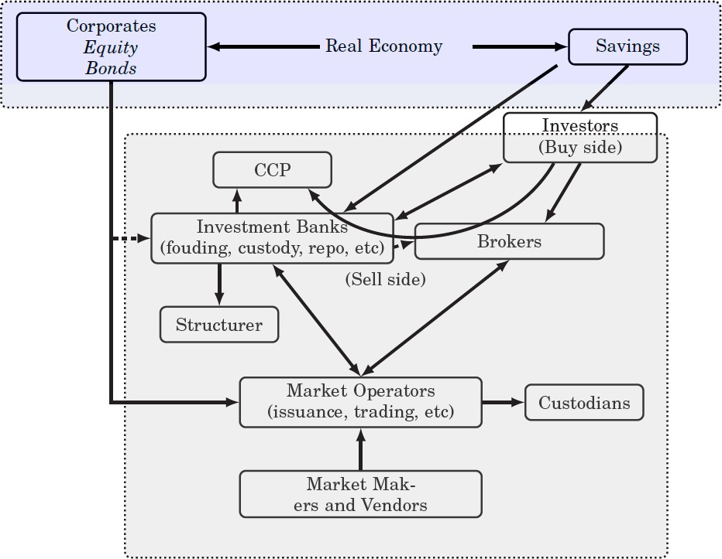
The Financial System

Slide 22
Role of the Financial System
The financial system is essentially an intermediary, A financial system provides (Robert Merton 1995)
a payments system for the exchange of goods and services
a mechanism for the pooling of funds to undertake large-scale indivisible enterprise
a way to transfer economic resources through time and across geographic regions and industries
a way to manage uncertainty and control risk
price information that helps coordinate decentralized decision-making in various sectors of the economy;
provides a way to deal with the asymmetric-information and incentive problems when one party has information that the other party does not about a financial transaction

Slide 23
Middleman Role: Issuers <-> Investors
Corporate Brokerage
Investment Banks have senior bankers, working on Corporates' debt)
When a company issue shares (or bonds), she needs a book runner to be in between her and the investors. Usually, the Broker guarantees a price per share (conditioned by the number of shares sold the first day).
It is the same to raise capital on markets (conditions are on volatility around the issuance and market volumes, guaranteed prices are pegged on market VWAPs),
it is the same for share buy back programs.
Some brokers are mandated by one company to make the market on their stocks.
Corporate Access
Brokers organize meetings (one-to-one or conferences) between issuers (mostly CFOs) and investors
Companies have the opportunity to explain their strategy
Investors have the opportunity to challenge the accuracy of explanations.
Analysis (research) -- Brokers issue reports on
macroeconomics (strategists)
companies and sectors (fundamental analysts)
systematic (factorial) portfolios (quantitative analysts).

Slide 24
Middleman Role: Investors <-> Investors
Block trading (OTC) - ``upstairs trading''
Broker's Sales traders (qualitatively) know the portfolio of investors (anonymity)
Especially because the Broker's Sales sold them Analysts' ideas
Some small brokerage firms are specialized in sectorial small cap liquidity seeking.
Can have discretion to find blocks for one week.
Market Easing – Facilitation
Take quantity at a negotiated price
by voice for large quantities
by electronic means for small quantities (answers at “the touch”).
a broker provides liquidity on other asset classes too, if needed.
Members of exchange – “common trading”
Historically brokers were the founders (and only members) of exchanges
Now they are clients of exchanges, and no more the first clients (market makers and HFT are more important).
In some exchanges, brokers can be privileged provided they pay for.
Brokers guarantee best execution, provide Direct Market Access and electronic services (algo trading, TCA and consultancy).

Slide 25
Middleman Role: Investors <-> Infrastructure
Regulation and market surveillance
Brokers are part of the surveillance infrastructure (risk limits)
They have to warn national authorities when they detect suspicious behavior
They work with exchanges and authorities when asked to
Clearing, Collateralization and Settlement
Brokers dispatch drop-copies of trades to keep track of investor’s positions where needed
Brokers are connected to CCPs and custodians, thus play the role of middlemen between end investor and infrastructures
Repo and financing
Prime brokers are providing repo, reverse repo and financing

Slide 26
Who pays whom ?
Issuers pay for corporate brokerage
but they come to brokers' conferences for free,
in exchange they increase their chances to be included into investors' portfolios.
Investors pay fees for trading
They have to trade anyway; thus, they consider they have to pay the fees
Before MIFID II, investors used to choose to pay high touch or low touch fees.
With high touch they have access to financial analysis (research) on top of electronic trading
MIFID II oblige brokers to unbundle execution and research, and to pay hard dollars for reports and meeting.
Investors vote at Extel Refinitiv and MorningStar surveys.
Most Buy-sides are using the Extel ranking as a repartition key to split their flows amongst brokers.
MorningStar survey is more quantitative than Extel, but less used.
This is a reinforcing ecosystem: the more clients you have the best ranked, thus it is very difficult for newcomers. This is good for concentration.
Investment banks pay to have a better market access and a better access to information.
the Brokerage business is overcrowded, nevertheless some Investment banks pay to maintain their brokerage arm alive.

Slide 27
Organization inside a brokerage firm
In a typical organization:
Sales: select and distribute the reports, they are in charge of the global sales relationship
Analysts: write the reports, talk to the CFO of the corporates and to investors 'Portfolio managers.
Sales-traders: take investors orders (by phone) via Dealing Desks and seek liquidity> They select and send flow-oriented reports ( often written by quant analysts ).They are in charge of upstairs trading , and route the remaining orders to traders or trading algorithms
Traders: mix manual and algorithmic traded orders
Dealers: manage broker’s prop books
AES sales-traders: receive and monitor algo orders sent directly by low touch clients. They are the only one to see the low touch flows. They offer execution consultancy to clients.
DMA teams: are monitorigin DMA orders and operate and help desk.
Middle and back offices: maintain the relationship with investors middle and back offices and with CCPS

Slide 28
Conclusion Questions ?

Slide 29
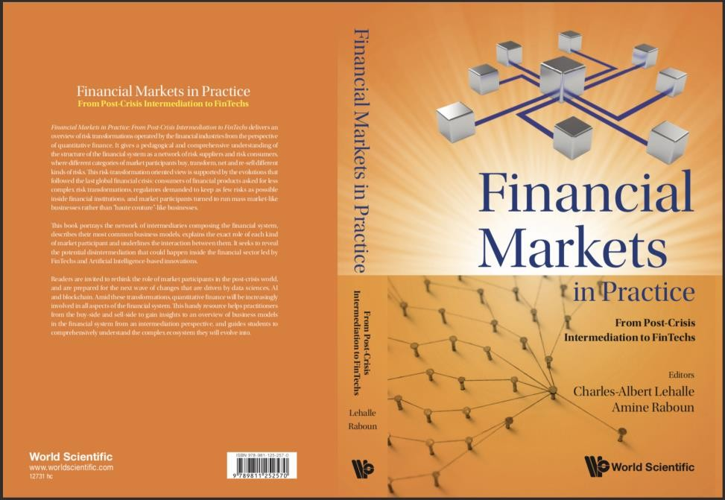
To go further
To go further:
Financial Markets in Practice: From Post Crisis Intermediation to FinTechs
by Charles-Albert Lehalle
and Amine Raboun
(World Scientific Publisher, June 2022)

